Slide 1
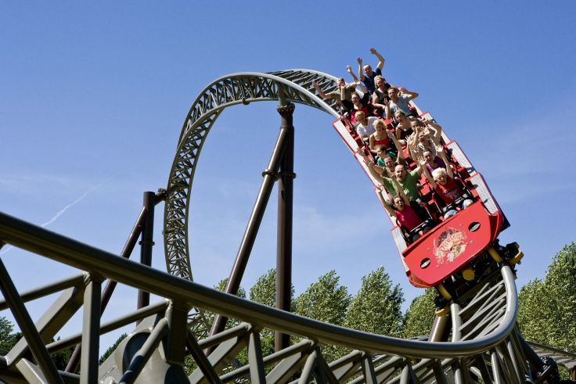
HeartRider
Jash Mahipal
Hao Fu
Zhuoming Li

Slide 2
AGENDA
Introduction
Problem
Solution
Demo
User Testing
Q&A

Slide 3
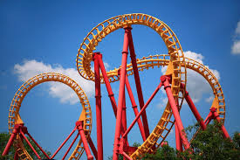
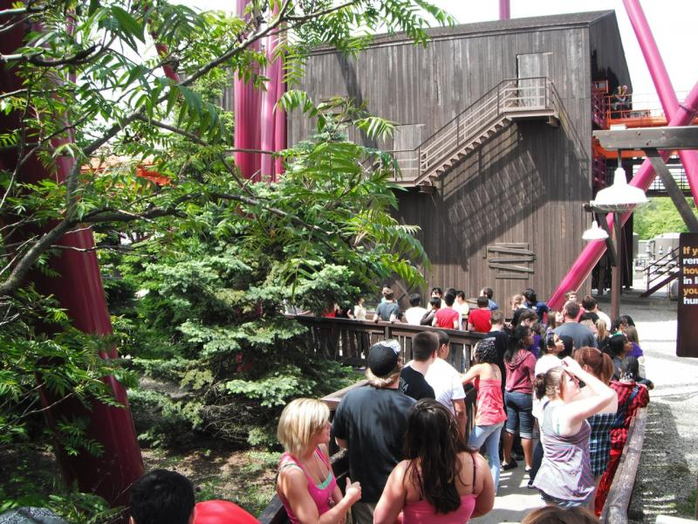
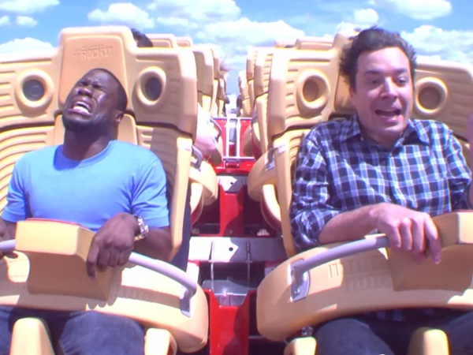
Introduction
Parks are associated with…

Slide 4
Introduction
… Long lines
1

Slide 5
Introduction
… and Fear
1
2

Slide 6


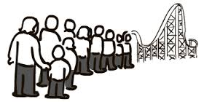




The Problem
Long Lines
Tired of waiting
Loss in Revenue
Avg. ~150 bpm
Heart Conditions
Source: American Heart Association
Fear

Slide 7
The Problem
Long Lines
Tired of waiting
Loss in Revenue
Avg. ~150 bpm
Heart Conditions
Source: American Heart Association
Fear

Slide 8



Target User
P
R
I
MARY
Heart Patients
SECONDARY
Families Optimizing Time
Curious Individuals

Slide 9
Target User
P
R
I
MARY
Heart Patients
SECONDARY
Families Optimizing Time
Curious Individuals

Slide 10

The Solution
Heart Rider
educate and ride

Slide 11







The Solution
Medical data
Share
Rate
Determine waiting time
Monitor
Visualize

Slide 12
Demo Three Tasks
Login and Enter Medical Data (Easy)
Determine Distance and Wait Time (Moderate)
Rate, Visualize and Share Heart Rate (Hard)

Slide 13

Demo Final Interface

Slide 14
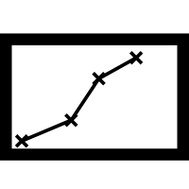


User Testing Technical Challenge and Solution
Original
Displayed Average Statistics

Slide 15
User Testing Technical Challenge and Solution
Original
Feedback
Visualize The Trend
And Normalize Data
Displayed Average Statistics

Slide 16
User Testing Technical Challenge and Solution
Original
Feedback
Solution
Visualize The Trend
And Normalize Data
Displayed Average Statistics
Multithreading

Slide 17
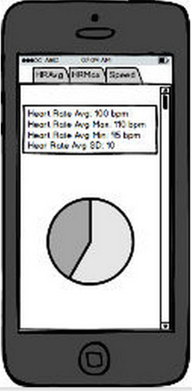
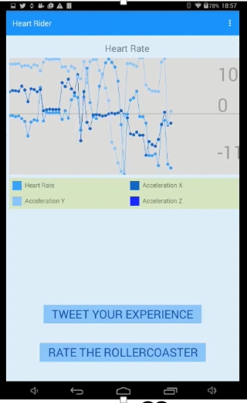
User Testing Technical Challenge and Solution
Before User Testing
After User Testing

Slide 18
Q & A

Slide 19
Thank you
Jash Mahipal | Hao Fu | Zhuoming Li

